Slide 1
Group One Final Presentation
Helen Fang, Austin Riis-Due, Saahithi Joopelli, Marco Di Leo, Nisha Ramesh

Slide 2
Background: Hingle Basin
The case study is presented as a 360 square mile tract of land
Given data spanning one year for 100 wells on the land
From this data we are asked to predict and optimize the locations of the next set of ten wells
Significance:
Good case study for practical oil and gas optimization

Slide 3
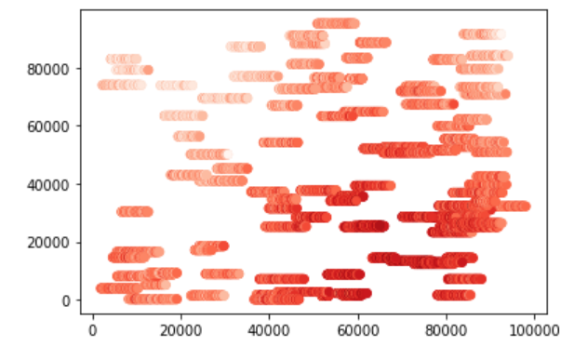
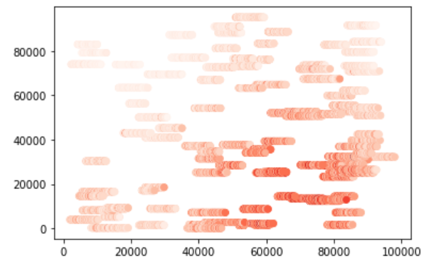
The Original Wells
High
Porosity
Permeability
Low

Slide 4
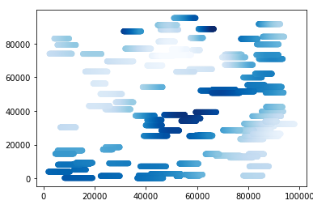

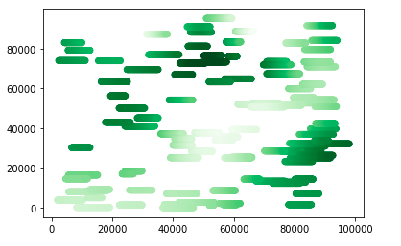
The Original Wells
High
High
Low
Low
Oil Saturation
Water Saturation

Slide 5
Objectives Part One:
Optimize the following to maximize production:
Well length
Based on predicted Recoverable Reserves?
How long can a well be physically?
Number of frac stages
What’s the correlation between production and frac stages?
How close to prevent cross interference?
Amount of proppant in each stage
What’s the correlation between production and proppant?
Pump Rate
What’s the correlation between production and pump rate?

Slide 6
Objectives Part Two:
Use your optimized well parameters to choose the location for the next 10 wells
Calculate the original oil in place (OOIP) for each well
How to get a parameter for width?
Calculate the recoverable reserves (RR) for each well
How to predict recovery factor based on other well properties?
Calculate the estimated ultimate recovery (EUR) for each well
What are the economic limits of production?
How much does it cost to run an oil well?

Slide 7
Analysis
Pandas, Seaborn, and MatPlot for statistical analysis
PKN fracture modeling to calculate width of thin wells
Proppant weight, frac stages, pump rate optimization: median values
lack of statistical correlation between those variables and oil production

Slide 8
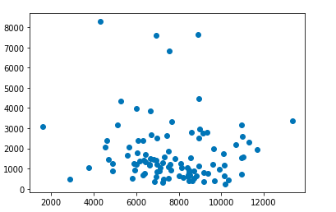
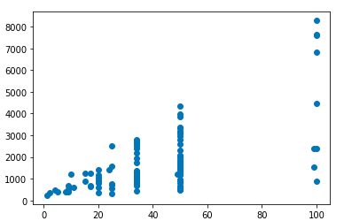
How does production vary with...
Annual oil production (bbl)
Annual oil production (bbl)
Number of frac stages
Well length (ft)
Well length
Frac stages

Slide 9
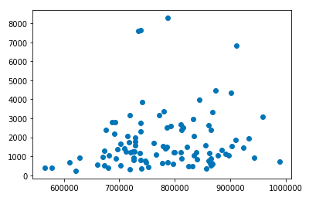
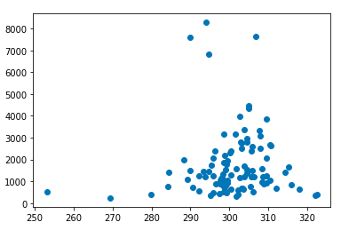
How does production vary with...
Annual oil production (bbl)
Annual oil production (bbl)
Average proppant weight (lb)
Average pump rate (cubic feet/min)
Proppant weight
Pump Rate

Slide 10
Feature Prediction: Random Tree Regression
Predictand space constructed from unoccupied locations
Use locations to determine well length
Predicted data reduced to find optimal locations
Broke up long wells with high production potential into smaller intervals

Slide 11


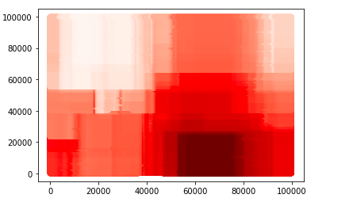
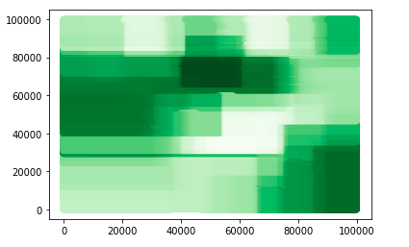
Predictions: Random Tree Regression
Porosity
Oil Saturation

Slide 12
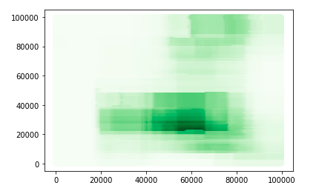
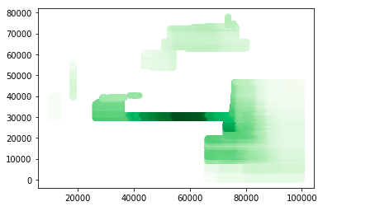
Predictions: Random Tree Regression
Recoverable Reserves
Reduced, measures above 50th percentile

Slide 13
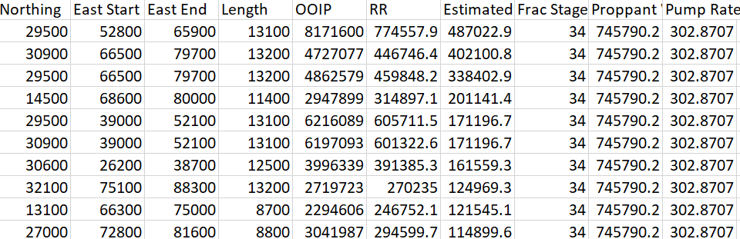
Results

Slide 14
Results
Summed oil in place: 45.17 MM bbl
Summed recoverable reserves: 4.41 MM bbl
Summed estimated ultimate recovery: 2.28 MM bbl

Slide 15
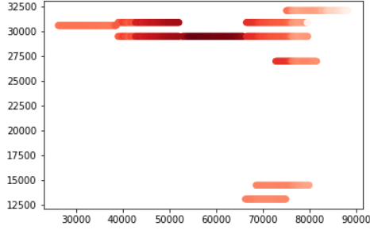
Map of Well Locations*
*Colored by recoverable reserves

Slide 16
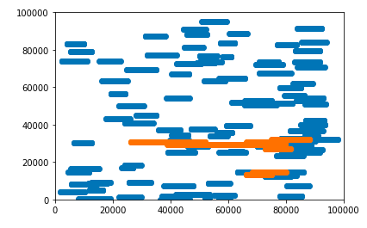
Map of Well Locations

Slide 17
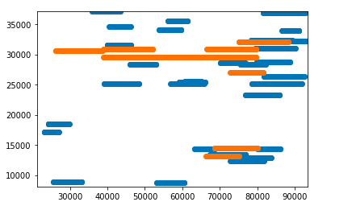
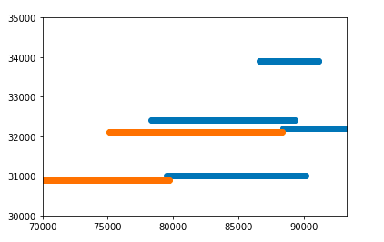
Map of Well Locations
(they do not overlap with existing wells)

Slide 18
Conclusions
There is a region located in the lower center of the basin where there is predicted to be a high amount of recoverable reserves
The wells are expected to have an average lifetime of 5.09 years before they reach the estimated economic limit of production
The lifetime of the wells is short because the Hingle basin is an unconventional play
The investment in these ten wells is expected to have a net profit of 25 million dollars per year after the estimated cost of the wells

